Slide 1


Introduction
How it works
Benefits and Potential Impact
Technical Details
Future Developments
Conclusion
Visual Pollution Detection
Presented by:
Faraz Ahmad Qureshi 200901045
Asad Abbas 200901024

Slide 2

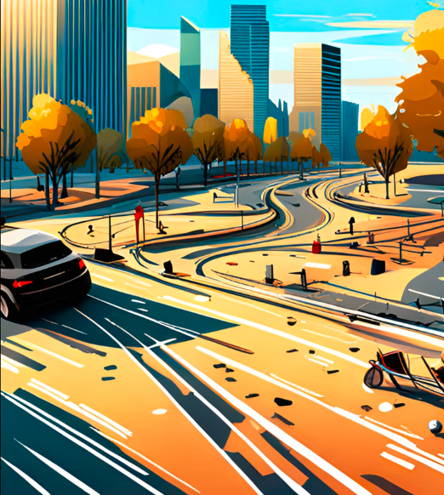
Visual pollution affects the safety and wellbeing of citizens on the road.
Introduction
How it works
Benefits and Potential Impact
Technical Details
Future Development
Conclusion
Introduction

Slide 3
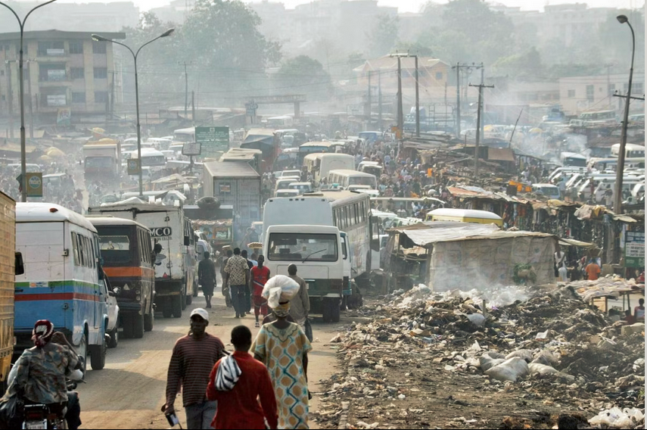
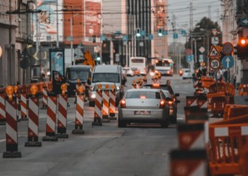
Introduction
Visual pollution affects the safety and wellbeing of citizens on the road.
Urban areas, especially in developing countries, are increasingly affected by visual pollution, which impacts health and environment.

Slide 4
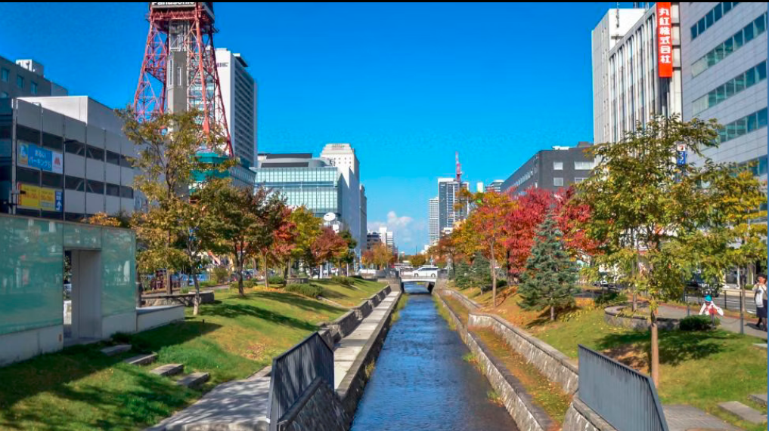


Introduction
Visual pollution affects the safety and wellbeing of citizens on the road.
Urban areas, especially in developing countries, are increasingly affected by visual pollution, which impacts health and environment.
Our app uses computer vision to spot visual pollutants and give each item a pollution score.
Users share pollution scores on social media to raise awareness

Slide 5

Introduction
Our app uses computer vision to spot visual pollutants and give each item a pollution score.
Users share pollution scores on social media to raise awareness
Urban areas, especially in developing countries, are increasingly affected by visual pollution, which impacts health and environment.
Introduction
How it works
Benefits and Potential Impact
Technical Details
Future Development
Conclusion

Slide 6

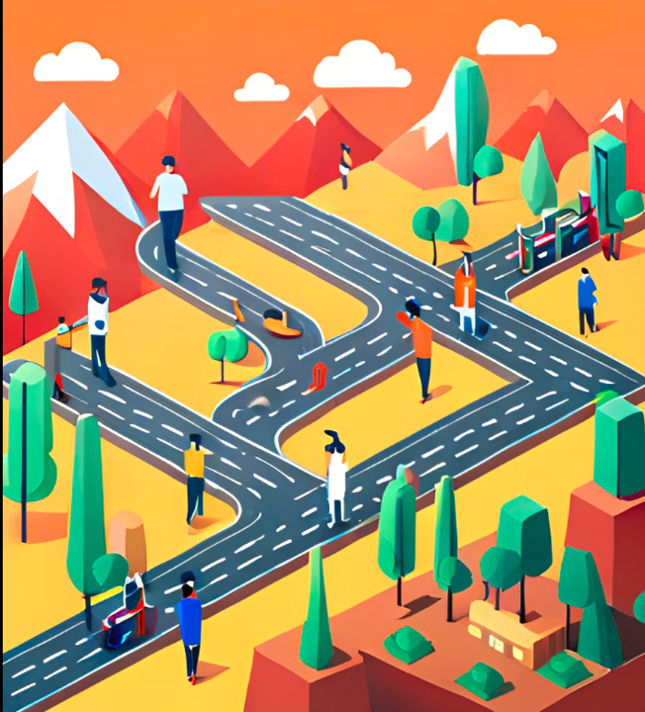
How it works
Benefits and Potential Impact
Technical Details
Future Development
Conclusion
Introduction
Our app uses computer vision to spot visual pollutants and give each item a pollution score.
Users share pollution scores on social media to raise awareness

Slide 7
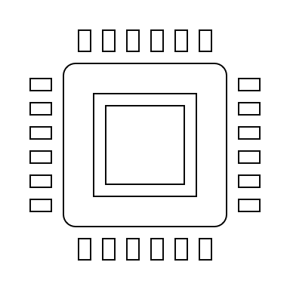
The computer vision-based mobile application works by using the smartphone's camera to capture live video of the road ahead
The app then analyzes the stream using a deep neural network model that has been trained on our visual pollution object dataset.

Slide 8

When the app detects any of these objects, it assigns a pollution index based on the severity of the object. For example, a large pothole would be assigned a higher pollution index than a small one
The computer vision-based mobile application works by using the smartphone's camera to capture live video of the road ahead
The app then analyzes the stream using a deep neural network model that has been trained on our visual pollution object dataset.

Slide 9

When the app detects any of these objects, it assigns a pollution index based on the severity of the object. For example, a large pothole would be assigned a higher pollution index than a small one
Users can view their pollution score and share it on social media platforms like Facebook to raise awareness about the issue.
The app then analyzes the stream using a deep neural network model that has been trained on our visual pollution object dataset.

Slide 10
When the app detects any of these objects, it assigns a pollution index based on the severity of the object. For example, a large pothole would be assigned a higher pollution index than a small one
Users can view their pollution score and share it on social media platforms like Facebook to raise awareness about the issue.

Slide 11



it raises awareness about visual pollution and encourages citizens to take action to address the issue.
Benefits and Potential Impact
Technical Details
Future Development
Conclusion
It helps to improve road safety by identifying potential hazards such as potholes and barriers

Slide 12

Benefits and Potential Impact
Technical Details
Future Development
Conclusion
It helps to improve road safety by identifying potential hazards such as potholes and barriers
it raises awareness about visual pollution and encourages citizens to take action to address the issue.
Finally, it provides valuable data that can be used by city planners and policymakers to make informed decisions about urban infrastructure development.

Slide 13
It helps to improve road safety by identifying potential hazards such as potholes and barriers
Finally, it provides valuable data that can be used by city planners and policymakers to make informed decisions about urban infrastructure development.
it raises awareness about visual pollution and encourages citizens to take action to address the issue.

Slide 14

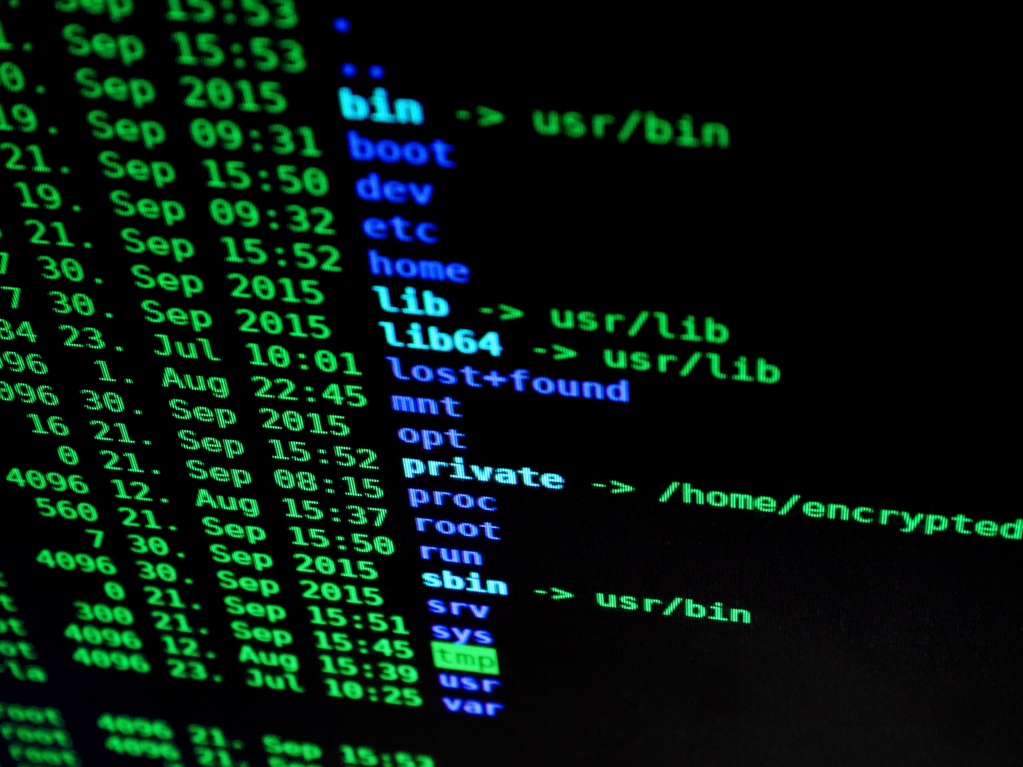
Technical Details
Future Development
Conclusion
Finally, it provides valuable data that can be used by city planners and policymakers to make informed decisions about urban infrastructure development.

Slide 15

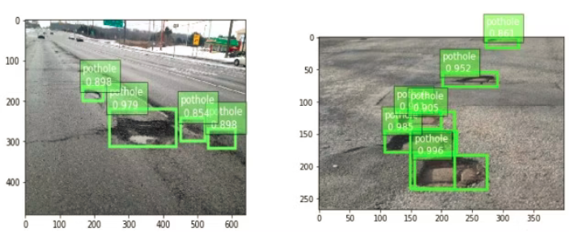
Dataset preparation and model training
Collecting a dataset of images of roads with visual pollutants is essential for training the deep learning model.

Slide 16
Collecting a dataset of images of roads with visual pollutants is essential for training the deep learning model.
we will be using pre processed dataset for our requirement
Annotation tools such as CVAT or Segment Anything Model can be used to speed up the annotation process.

Slide 17
Collecting a dataset of images of roads with visual pollutants is essential for training the deep learning model.
we will be using pre processed dataset for our requirement
Annotation tools such as CVAT or Segment Anything Model can be used to speed up the annotation process.

Slide 18

Deep Learning
A deep learning model such as YOLOv8 or Faster R-CNN can be trained to recognize the visual pollutants in the images.
One of the challenges is that this process requires high graphical computing power if done on local environment.

Slide 19
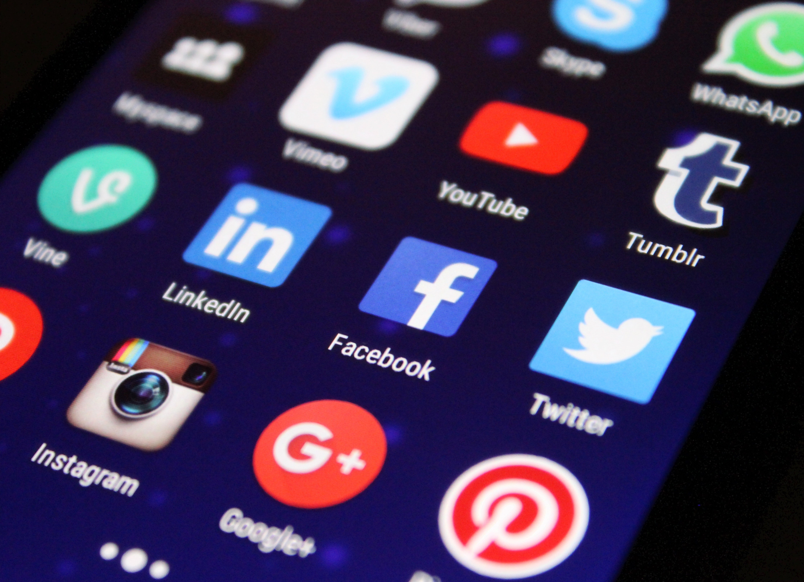
Mobile App Development:
Development in Kotlin
Convert model using TensorFlow Lite
Users will be able to share their pollution index scores on social media platforms such as Facebook, Twitter, or Instagram.

Slide 20
Future Development
Adding GPS Tagging for real time road quality updates
Creating a comprehensive database of visual pollution across any route in a city

Slide 21
Q/A ?

